Slide 1
CNN POOLING

Slide 2
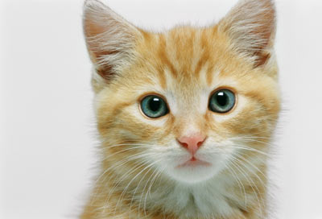
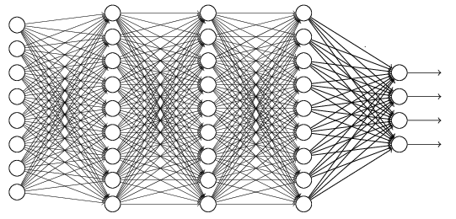
The whole CNN
cat dog ……
Convolution
Max Pooling
Fully Connected Feedforward network
A new image
Convolution
Max Pooling
Flattened
A new image

Slide 3
Flattening
3
0
1
3
0
-1
1
3
3
1
-1
0
3
Flattened
1
Fully Connected Feedforward network
0
3

Slide 4


CNN in Keras
Only modified the network structure and input format (vector -> 3-D tensor)
input
Convolution
1 | -1 | -1
-1 | 1 | -1
-1 | -1 | 1
-1 | 1 | -1
-1 | 1 | -1
-1 | 1 | -1
There are 25 3x3 filters.
……
Max Pooling
Input_shape = ( 28 , 28 , 1)
28 x 28 pixels
1: black/white, 3: RGB
Convolution
3
-1
3
Max Pooling
-3
1

Slide 5
CNN in Keras
Only modified the network structure and input format (vector -> 3-D array)
Input
1 x 28 x 28
Convolution
How many parameters for each filter?
9
25 x 26 x 26
Max Pooling
25 x 13 x 13
Convolution
How many parameters
for each filter?
225=
25x9
50 x 11 x 11
Max Pooling
50 x 5 x 5

Slide 6
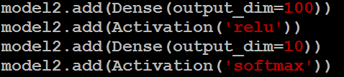
CNN in Keras
Only modified the network structure and input format (vector -> 3-D array)
Input
1 x 28 x 28
Output
Convolution
25 x 26 x 26
Fully connected feedforward network
Max Pooling
25 x 13 x 13
Convolution
50 x 11 x 11
Max Pooling
1250
50 x 5 x 5
Flattened

